Slide 1

Welcome to our Department of Mechanical Engineering
Internship Office ACES – Sample Presentation Slides for Internship Seminar
(!!! Only a completed example!!!)

Slide 2
Outline of the presentation
Website of Audi / BMW / Mercedes-Benz AG/ etc.
Four of our eleven Chairs/Institutes are presented as an example
Overview of partners and competitors
Overview of suppliers
Overview of customers
Bibliography / References
(!!! Only a completed example!!!)

Slide 3

Introduction: Electromobility ACES
  Electromobility-ACES (“Elektromobilität-ACES”) *NEW*
      New interdisciplinary course, represents an attractive offer for prospective students
Master can be studied completely in English
More information
about Internship Office ACES:
German: https://www.aces.studium.fau.de/studierende/praktikum/
English: https://www.aces.study.fau.eu/students/internship/
(!!! Only a completed example!!!)

Slide 4

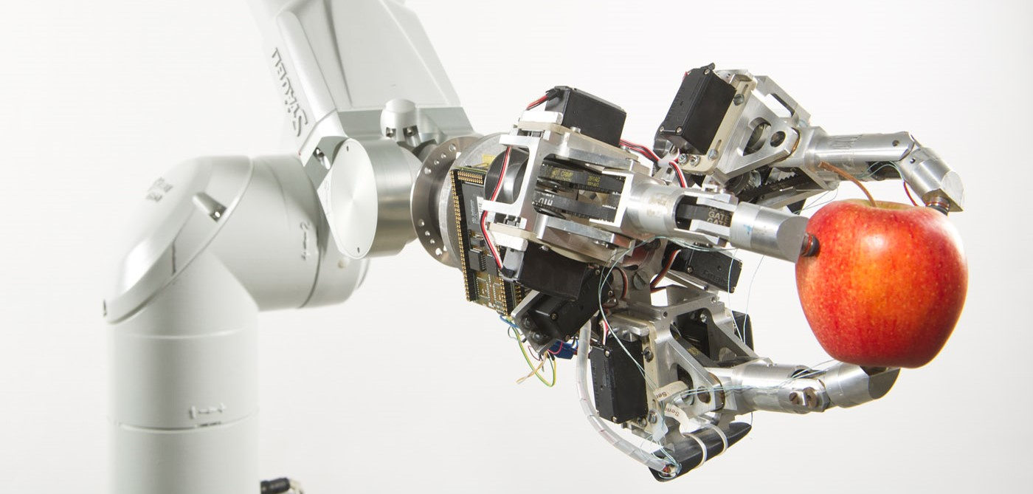
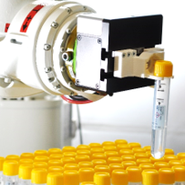
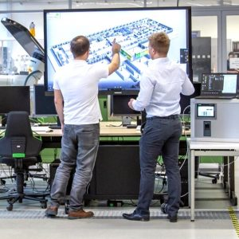
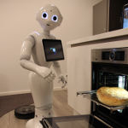
FAPS – Institute of Factory Automation and
Production Systems
Prof. Jörg Franke
Research
Robotics
Engineering Systems
Automation Technology
Medical Technology
Electronics Production
Electromechanical Engineering
Signal and Power Networks
Home Automation
(!!! Only a completed example!!!)
Teaching
Production Systems
Handling and Assembly Technology
Basics of Robotics & Robotics Frameworks
Industry 4.0, Software Development
Production Processes for Electronics
International Supply Chain Management
https://www.fau.eu/2022/04/26/news/research/prof-dr-paul-steinmann-awarded-second-erc-advanced-grant/
https://www.faps.fau.de/

Slide 5

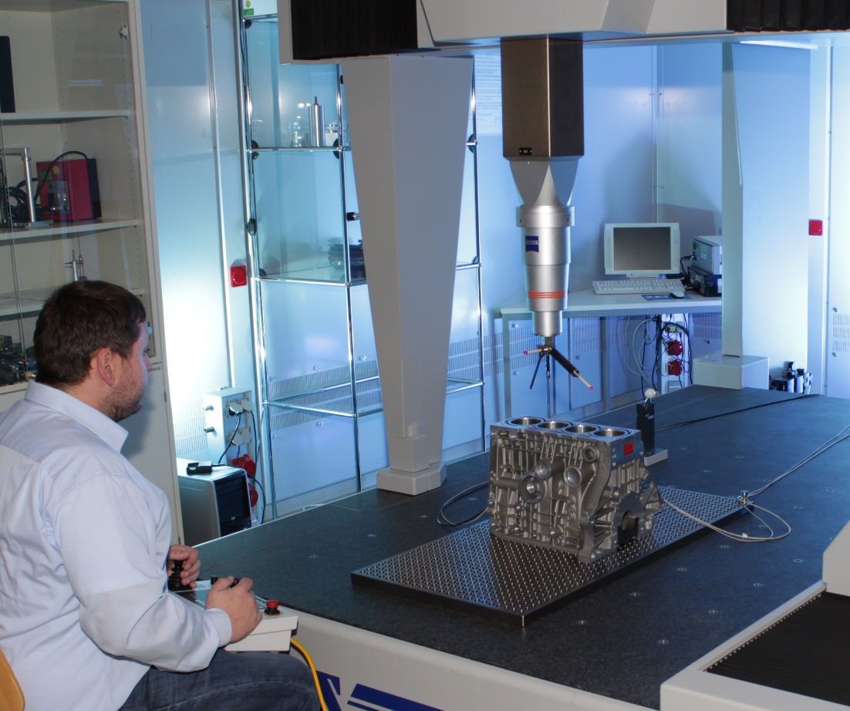
FMT – Institute for Manufacturing Metrology
Prof. Tino Hausotte
(!!! Only a completed example!!!)
Research
Interference optical length measurements
Coordinate and surface metrology
Photogrammetry and Image Processing
X-ray Computer Tomography
Registration, stiching and fusion of measurement data
Measurement resolution
Analysis of measurement uncertainty
Teaching
Fundamentals of Metrology
Manufacturing Metrology
Process and Temperature Measurement Technology
Computer-aided Metrology
Quality Management
Service Quality Engineering
https://www.fau.eu/2022/04/26/news/research/prof-dr-paul-steinmann-awarded-second-erc-advanced-grant/
https://www.fmt.tf.fau.de/

Slide 6

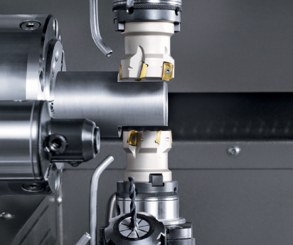
REP – Institute for Resource and Energy Efficient Production Machines
Prof. Nico Hanenkamp
(!!! Only a completed example!!!)
Research
Lean Management
Data Mining for Shopfloor Management
Machine Learning in Operations
Resource and energy efficient Design of process chains
Process stabilization
Analysis of the machinability using different combinations of tools and material
Teaching
Efficiency in factory operations and operational excellence
Resource efficient Production Systems
Production Engineering
Advanced Seminar on International and Sustainable Production
https://www.fau.eu/2022/04/26/news/research/prof-dr-paul-steinmann-awarded-second-erc-advanced-grant/
https://www.rep.tf.fau.de/

Slide 7

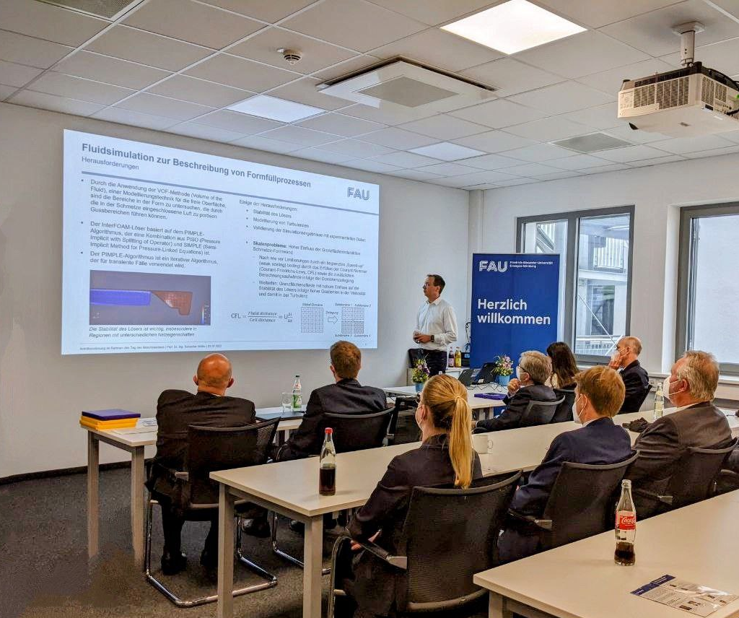
LGT – Institute for Casting Technology
Prof. Sebastian Müller
Research
Simulation
Optimization
High pressure Die Casting
Advanced Casting Technologies
Teaching
Casting Technology
Fundamentals of fluid modelling with OpenFOAM
Fundamentals of PYTHON- and MATLAB-based data acquisition and optimization
Material Characterization in Forming and Joining Technologies
(!!! Only a completed example!!!)
https://www.fau.eu/2022/04/26/news/research/prof-dr-paul-steinmann-awarded-second-erc-advanced-grant/
https://www.lgt.tf.fau.de/

Slide 8
Overview of partners and competitors
(!!! Only a completed example!!!)
Austria
  UMIT, The Tyrolean Private University, Hall
Croatia
  University of Zagreb, Zagreb
Denmark
  University of Southern Denmark, Odense
Finland
  Lappeenranta University, Lappeenranta
  Tampere University of Technology, Tampere
  Tampere University of Technology, Pori Department, Pori
France
  École Normale Supérieure de Cachan ENS, Cachan (Paris)
  Université de Technologie de Compiègne, Compiègne
  École Normale Supérieure Paris-Saclay, Paris-Saclay / Gif-sur-Yvette
  Université de Bourgogne, Dijon
  Université de Rennes, Rennes
  ESIGELEC École supérieure d’ingénieurs en génie électrique, Saint-Etienne du Rouvray (Rouen)
Greece
  Aristotle University of Thessaloniki, Thessaloniki
Hungary
  Budapest University of Technology and Economics, Budapest
Ireland
  Maynooth University, Dublin
Italy
  Università degli Studi di Napoli Federico II, Neapel
  Università degli Studi di Padova «Il Bo», Padua
  Università degli Studi di Palermo, Palermo
  Università di Pisa, Pisa
  Università degli Studi di Udine, Udine
Latvia
  Riga Technical University, Riga
https://www.department.mb.tf.fau.de/outgoings/

Slide 9
Overview of suppliers
United Kingdom of Great Britain and Northern Ireland
  Staffordshire University, Staffordshire
  China
  East China University of Science and Technology (ECUST), Shanghai
  University of Michigan – Shanghai Jiao Tong University Joint Institute, Shanghai
Canada
  Ontario Tech University, Oshawa
Taiwan
  National Yang Ming Chiao Tung University (NYCU), Hsinchu
  Feng Chia University (FCU), Taichung
We are always open for new student exchange cooperations!
Please contact us.
(!!! Only a completed example!!!)
https://www.department.mb.tf.fau.de/outgoings/

Slide 10
Overview of customers
(!!! Only a completed example!!!)
Lithuania
  Vilnius Gediminas Technical University, Vilnius
Poland
  Warsaw University of Technology, Warsaw
Portugal
  Universidade de Lisboa, Lisbon
Romania
  Technical University of Cluj-Napoca, Cluj-Napoca
Sweden
  Dalarna University, Falun
  Mälardalen University, Västeras
Slovenia
  University of Ljubljana, Ljubljana
  University of Maribor, Maribor
Spain
  Universitat Poltècnica de Catalunya, Barcelona
  Universidad del País Vasco, Bilbao
  Universidad de Burgos, Burgos
  Universidad de Cádiz, Cadiz
  Universidad Politécnica de Cartagena, Cartagena
  Universidad Pontificia Commillas, Madrid
  Universidad Politécnica de Madrid, Madrid
  Escuela Superior de Ingenieros de San Sebastian, TECNUN Campus Tecnológico
  de la Universidad de Navarra, San Sebastian
  Universitat Politècnica de València, Valencia
  Universidad de Vigo, Vigo
  Universidad de La Laguna, La Laguna, Tenerife
  Universidad de Las Palmas de Gran Canaria, Las Palmas, Gran Canaria
  Universitat de les Illes Balears, Palma de Mallorca
Turkey
  Atilim University, Ankara
  Yildiz Technical University, Istanbul
  Dokuz Eylül University, Izmir
https://www.department.mb.tf.fau.de/outgoings/

Slide 11
Bibliography / References
(!!! Only a completed example!!!)
Website of Audi /BMW/Mercedes-Benz AG/ etc.
German: https://www.aces.studium.fau.de/studierende/praktikum/
English: https://www.aces.study.fau.eu/students/internship
https://www.faps.fau.de/
https://www.fmt.tf.fau.de/
https://www.rep.tf.fau.de/
https://www.lgt.tf.fau.de/
https://www.department.mb.tf.fau.de/outgoings/

Slide 12
(!!! Only a completed example!!!)
Thank you for your attention.

Slide 13
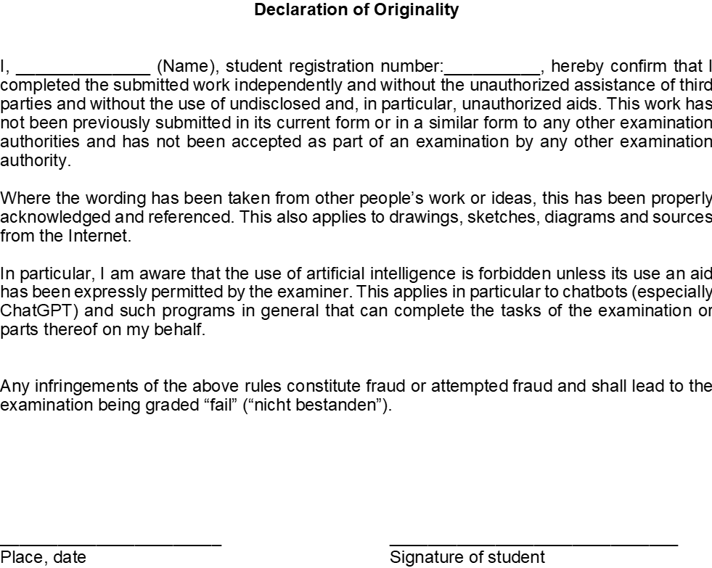


Signature Template for Students and Supervisors at company
(!!! Only a completed example!!!)
This slide must always be available at the end of every presentation!
All parties, both students and the supervisor in the company, must complete it with the date and signature.
If this slide or even just one signature is missing, unfortunately no recognition in the form of the internship seminar can take place!
Please make sure that the content is complete, including all sources and all other requirements according to the internship guidelines!
123456789
__________ _____________________
Place, date Signature of Supervisor
Erlangen, 11.11.11
Max Mustermann
12.12.11
Abteilungsleiter Klaus Müller

